Slide 1

Eastern Canada and Caribbean District of Kiwanis International
IMPROVING COMMUNICATION WITHIN OUR CLUBS
District Education Committee – updated 2016

Slide 2

Communication or Conversation?
Typically a two way street
Notes:
Wikipedia definition – Communication is the activity of conveying information
through the exchange of thoughts, messages or information as by speech, visuals,
signals, writing or behavioural.
Communication requires a sender, a message, and a recipient.
The communication process is complete once the receiver has understood the message of the sender.

Slide 3

Turning Communication into Conversation
Kiwanis One web site has a Power Point presentation titled “Turning Communication into Conversation”.
Some of the following statements are extracted from that presentation.
Communication is telling, conversations are sharing
Communication is traditionally one way, conversations is two way
Communications distribute information, conversations create understanding
Communication is often sterile, conversation is personal.
Conversations are more effective than communications
Conversations build relationships
Great leaders have great conversations & great relationships

Slide 4
12 Ways to help Improve Communication and Conversations
#1
Regular reminders about changes –
E-mail address/street address etc.
Use e-mail to keep members informed
Use printed material for those who do not utilize electronic technology
Use the “request for receipt or read” notice for important information sent by e-mail
Notes:
1)Develop a regularly scheduled plan in your club to ensure that everyone’s e-mail address is always current. Put regular reminders in your club bulletin. Be sure that members know the procedure within your club for keeping their contact information up to date with KI via the Secretary using the Secretary Dashboard.
Use email etc. to keep members informed, use printed matter for those who do not utilize electronic technology to keep informed. Use the request for receipt or read notice for important information to ensure the material has been received.

Slide 5
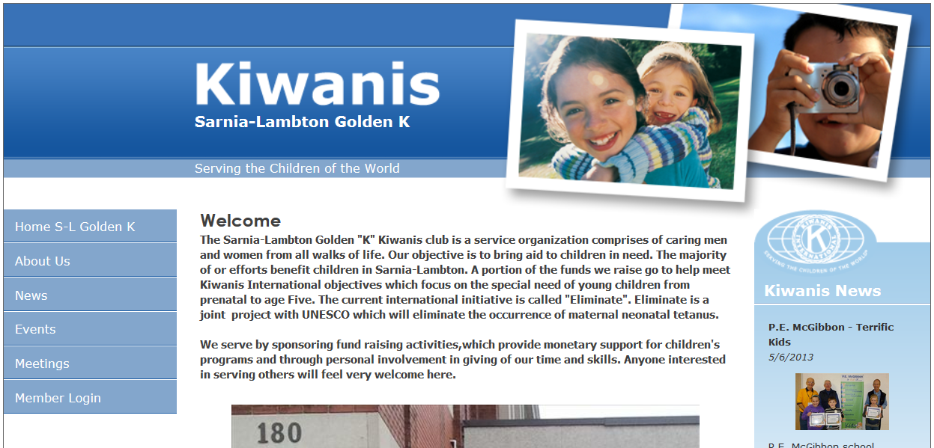
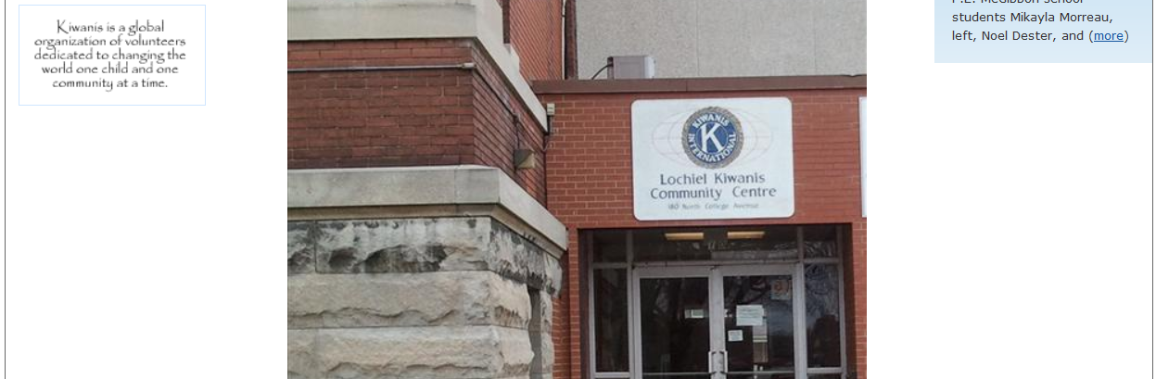
#2
Notes:
2. Use Club Website
– needs to be kept updated and user friendly. Encourage use, demonstrate navigation to members, more than once may be required

Slide 6
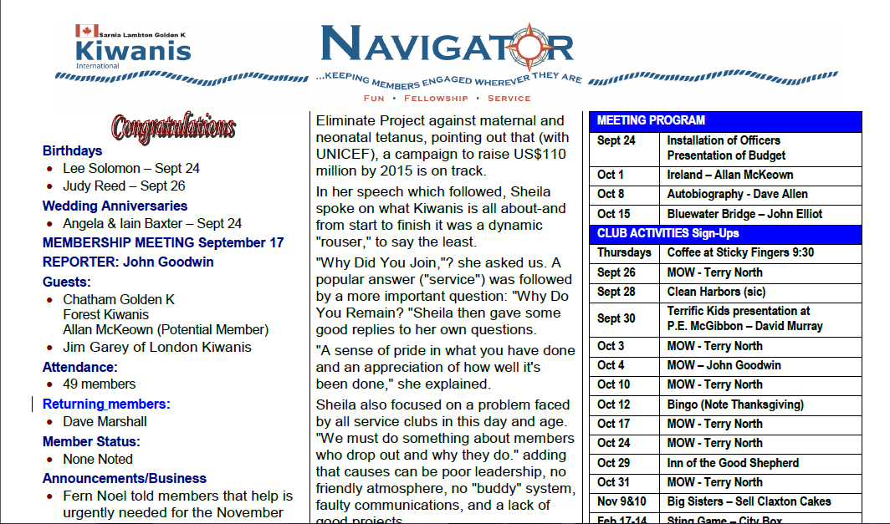
#3
Notes:
3. Use club newsletters/bulletins to convey the message to members

Slide 7

#4
I’ve got some information for you!
Lt. Governor’s play an important part in communication as do the President and Secretary of your club
Notes:
4) Lt. Governor’s will forward information to both the President and Secretary as per the District Communication protocol.
The President will determine who in your club will be responsible for sharing information with the members based on the message content.
This may be the club’s Image, Investment, Impact or Inspiration Chair, President or Secretary.
Ensure that there is a back-up plan to cover the times when the designated person is away.
Do not filter the material. All communication should be passed onto the club membership.

Slide 8

#5
Short committee reports at meetings
Report your successes
Keeps opportunities for service visible
Lets membership know we are active and doing useful service
Notes:
5) Short committee reports at meetings, weekly if necessary, to keep members informed of what is happening with present or near term projects and events including your SLP projects. Report on successes as well.
This will keep opportunities for service visible, let members know we are active and doing useful things and help recruit visitors as members.

Slide 9

#6
Business meeting at least once per month immediately after club board meeting.
Report on events
Analyse club needs/strengths
Address issues
Notes:
6) Business Meeting at least once per month immediately after the Club Board meeting to report
details on events and projects, analyse club needs and strengths and address any other issues of importance.

Slide 10

#7
http://www.kiwanis.org/theformula/strengthen-your-club/achieving-club-excellence/achieving-club-excellence-the-home-edition#.V5tpejUjZsl
Notes:
7. Utilize available materials such as the Club Excellence Tool, We Welcome You to Our Club etc
to assess the members’ perception of club strengths and weaknesses. Assign an individual or committee to evaluate the responses and see what needs to be addressed and by whom. Follow up on progress and report to the Board if needed.

Slide 11
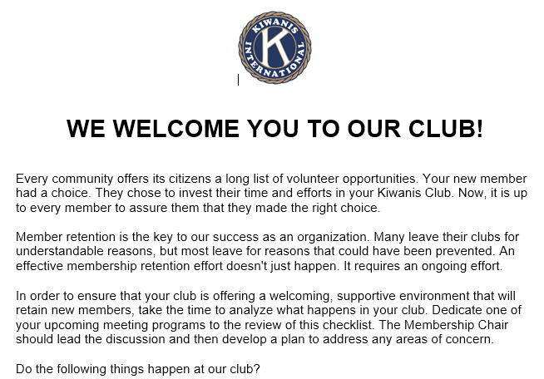
#7
Notes:
New Member Check List – Can be located on the EC&C web site under the Kiwanis I-Plan tab – Education. It is located under the New Member Orientation Presentation.

Slide 12

#8
Phone lists can get an urgent message out to all club members quickly and efficiently.
Notes:
8. Develop a phone list to get urgent messages to all club members. An example would be a pyramid phone contact list
– first person calls 2 people, they in turn each call 2 people and so on until the entire membership is informed.

Slide 13

#9
Do a club analysis regularly to see if your club is on the right track
Notes:
9. Analyse your club regularly (once/year) to learn what members like and dislike about what the club is doing. Learn what they want to spend their time and energy on since we are all busy and don’t want our time wasted.
Don’t be afraid to let things go if they no longer fulfill your club or community goals and aspirations.
Don’t be afraid of trying new things – keep it interesting and relevant.
It is important for all members to feel that their opinions are heard and valued, even though you can’t promise that all can be acted upon.

Slide 14

#10
Encourage members to attend board meetings
Creates openness and accountability
Notes:
10. Encourage all members to attend Board meetings to see what is done behind the scenes and what it takes to keep the club running. This also helps to create an atmosphere of openness and accountability.

Slide 15

#11
Host a New Member Orientation event
Educate them on Kiwanis
Have FUN!
Notes:
11. New Member Orientation event. Have an event for all members to attend but specifically geared for new and recent new members (last 2 or 3 years or since the last event). Use this to educate them on the club’s history and traditions, how Kiwanis operates, projects and events etc. This can also be very informative to longer standing members who may have forgotten some or a lot of the information. A good turnout can make for a fun event and helps the new members feel supported.

Slide 16

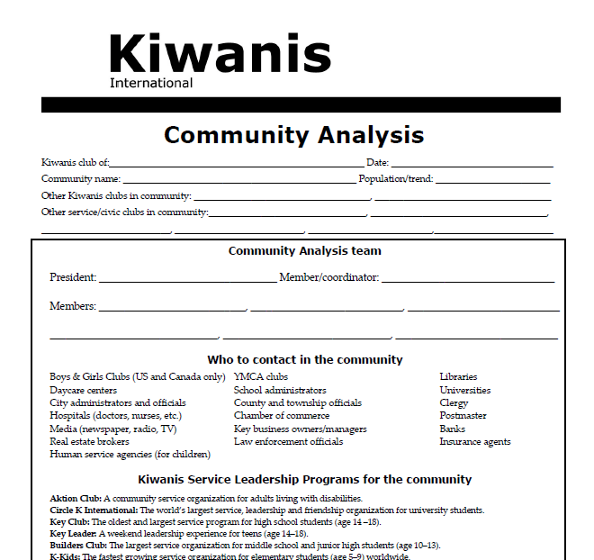
#12
Notes:
12. Utilize KI produced material to assist with keeping your conversations relevant.
Examples are – The Club Excellence Tool, Community Analysis and Planning your Club’s Success.
http://www.kiwanis.org/theformula/strengthen-your-club/achieving-club-excellence/achieving-club-excellence-the-home-edition#.V5tpejUjZsl

Slide 17

Questions??

Slide 18

Thank you for being
a part of Kiwanis!

