Slide 1
Navigating the Information Highway
A Guide for Every Kiwanian
Prepared by the EC&C District Education Committee 2016

Slide 2
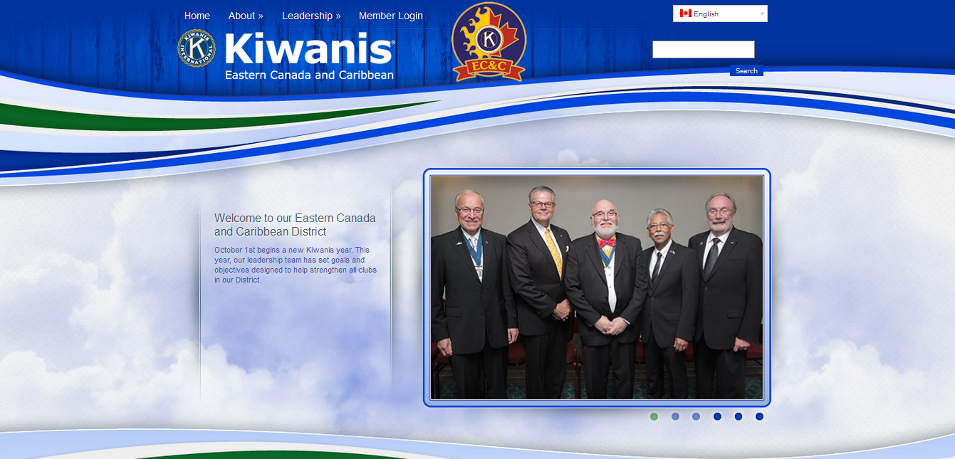
Do you know this website?? Everything you do starts here! – www.kiwanisecc.org

Slide 3
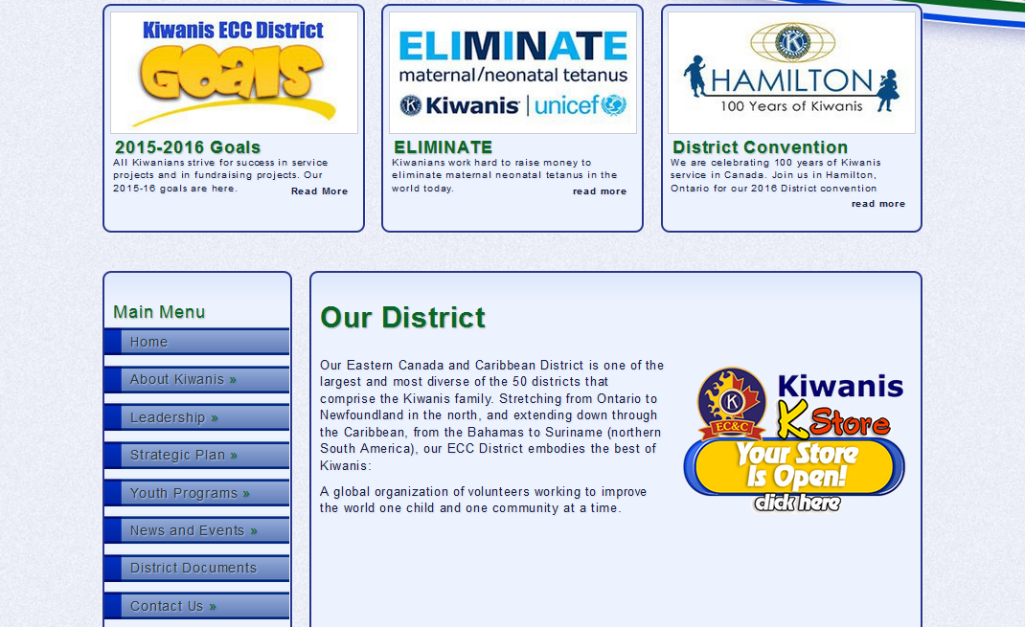
Scroll down and there is more to see!

Slide 4
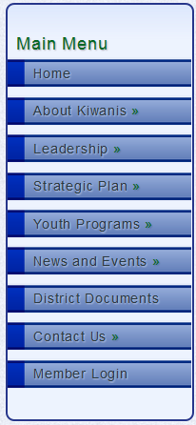
Each tab is your connection to important information
About Kiwanis tab lists all clubs in ECC and websites
Bilingual presentation for some documents
Listing of District Leadership and contact info under the Leadership tab
Includes District Administrators & District Chairs, Trustees etc.
Links to our Service Leadership Family are listed under Youth Programs tab
District Newsletter is under the News and Events tab
District Documents contains important info

Slide 5
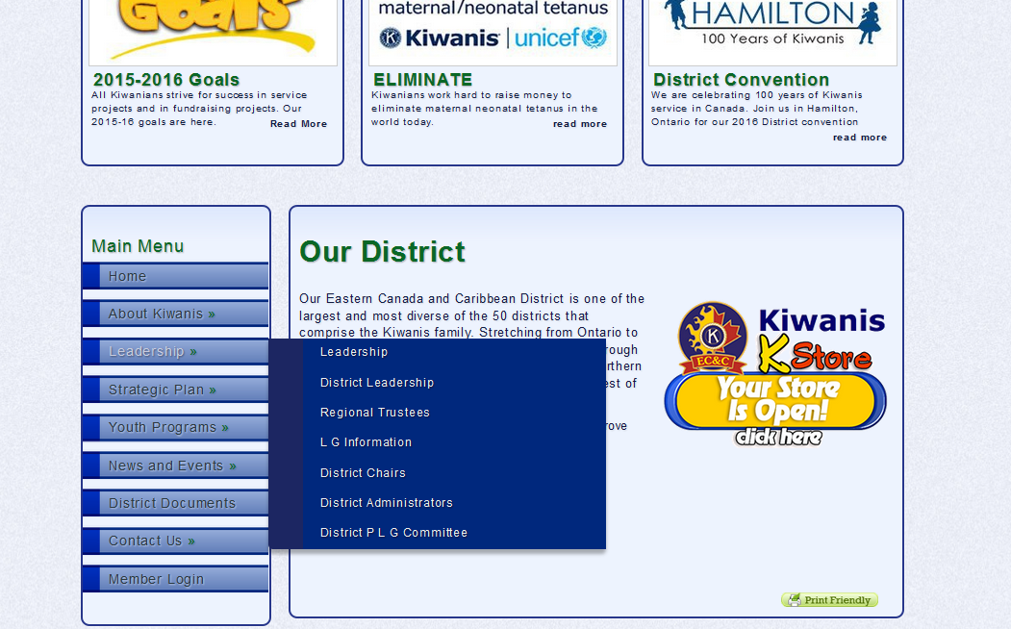
Hover over a tab along the left hand side and sub-menus will be revealed where you can find all sorts of information

Slide 6
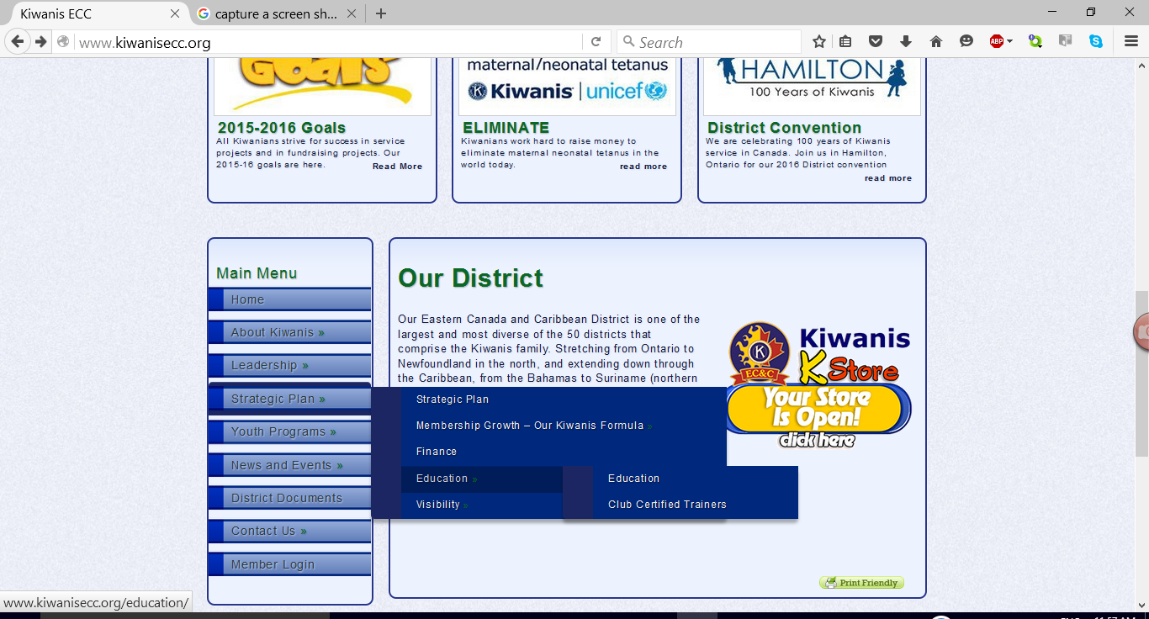
Strategic Plan tab is where you will find the following education items for each pillar –

Slide 7

You can’t break it!
Go on an adventure and discover what dwells behind each tab on our new EC&C website
Go on, you can do it!!!

Slide 8
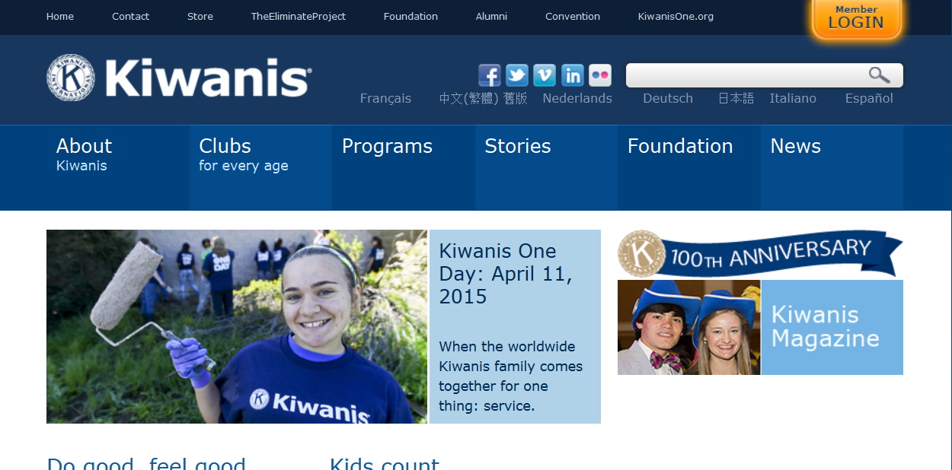
This should be a website that you are familiar with - www.kiwanis.org
This is the public side of our organization.

Slide 9
These are the tabs across the top of public home page – www.kiwanis.org
These are the tabs across the top of the www.kiwanisone.org home page
They are slightly different as are the tabs just below the word “Kiwanis”

Slide 10
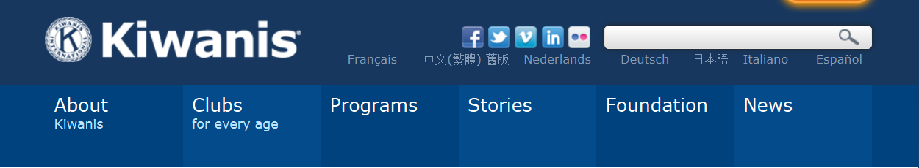

Kiwanis.org home page tabs
Kiwanisone.org home page tabs

Slide 11
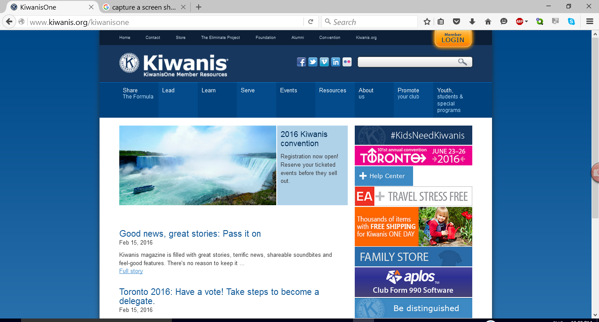
This is www.kiwanisone.org

Slide 12

All members can log in through Portalbuzz.
You can access it by clicking on the “Member Login” button at the top of the screen.
You will be taken to Kiwanis Connect

Slide 13
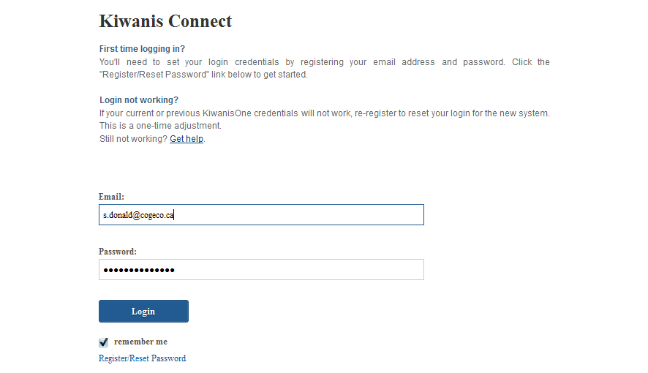

Slide 14
Instructions are on the screen if you have never logged into the system
All members can log in to find on-line education and other important information
We will return to this in a bit
Also the jumping off point for clubs that use the Full Club Management System

Slide 15
Across the top of the kiwanisone web site you will see these tabs
If you hover over each tab, sub-menu items appear

Slide 16
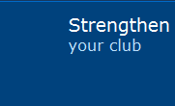
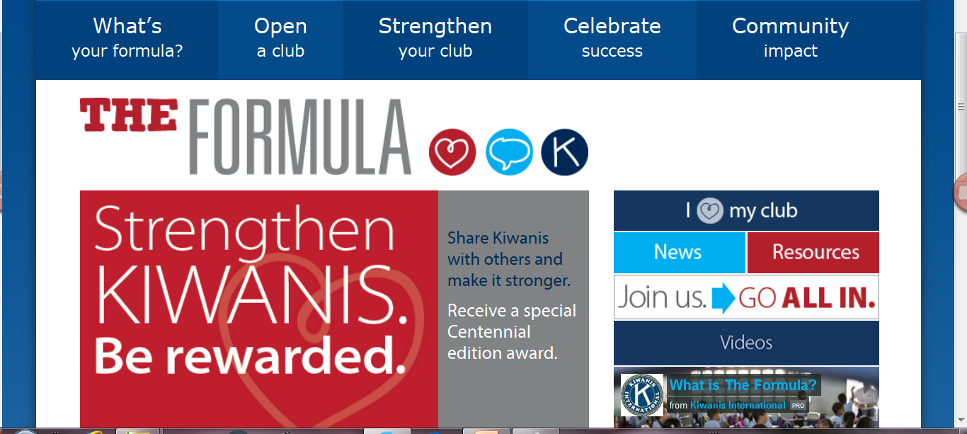
Takes you to information to help your club

Slide 17
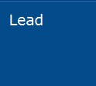
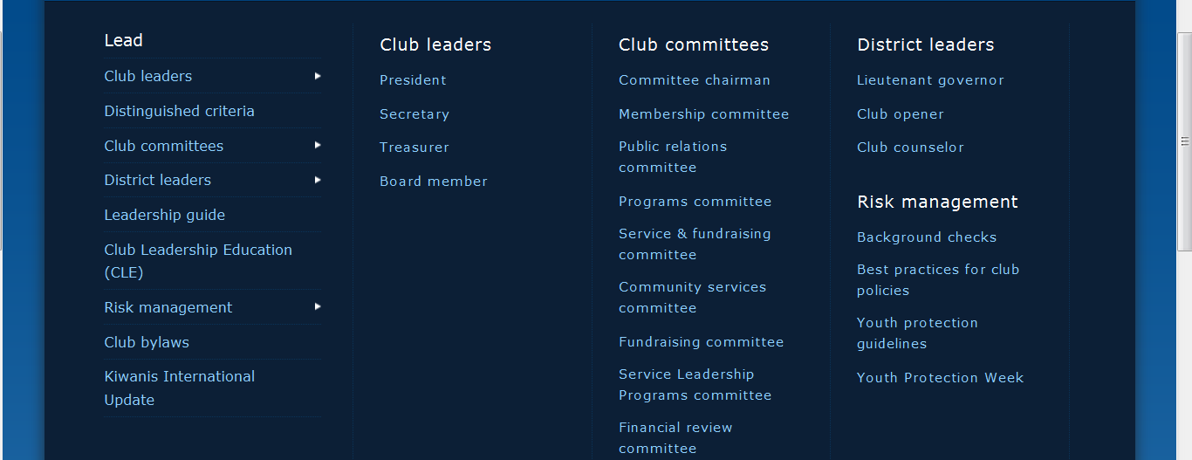
www.kiwanisone.org

Slide 18
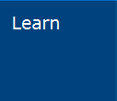
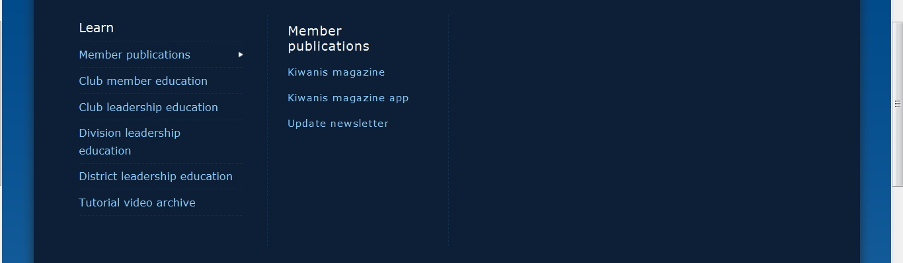
www.kiwanisone.org

Slide 19
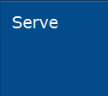
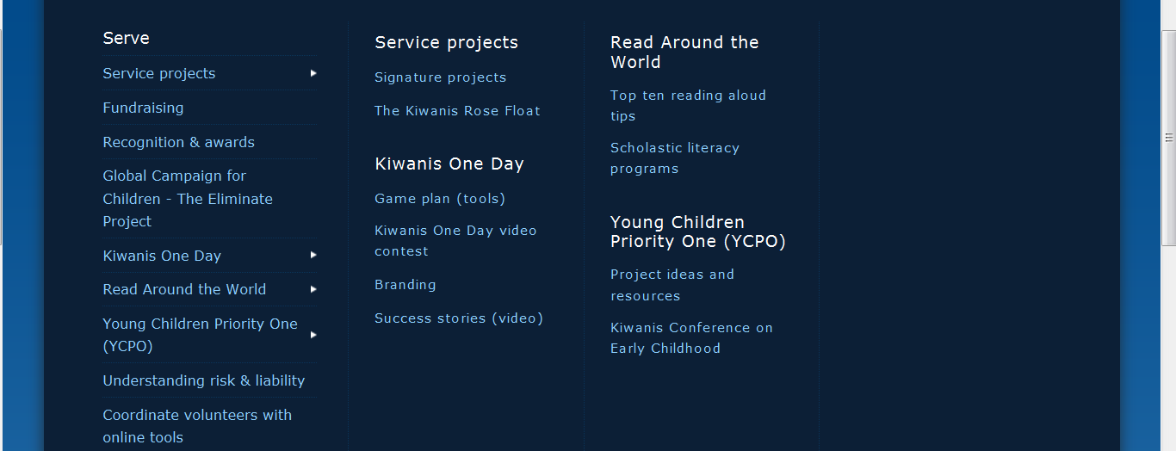
www.kiwanisone.org

Slide 20

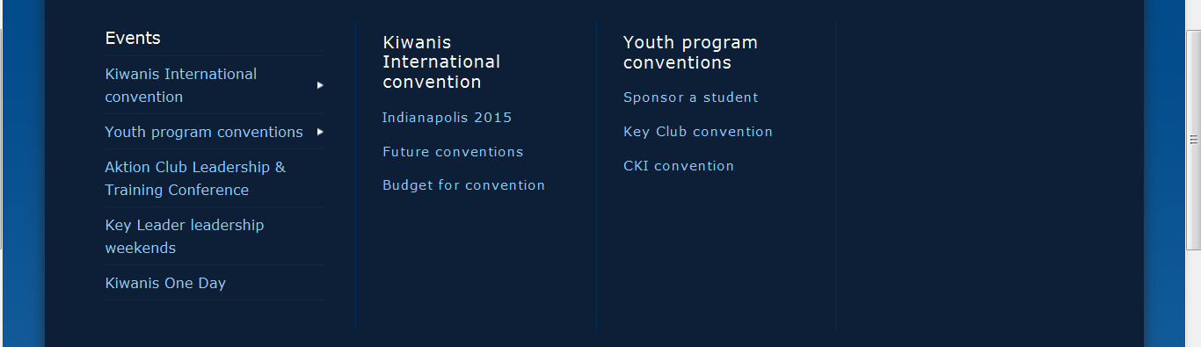
www.kiwanisone.org

Slide 21

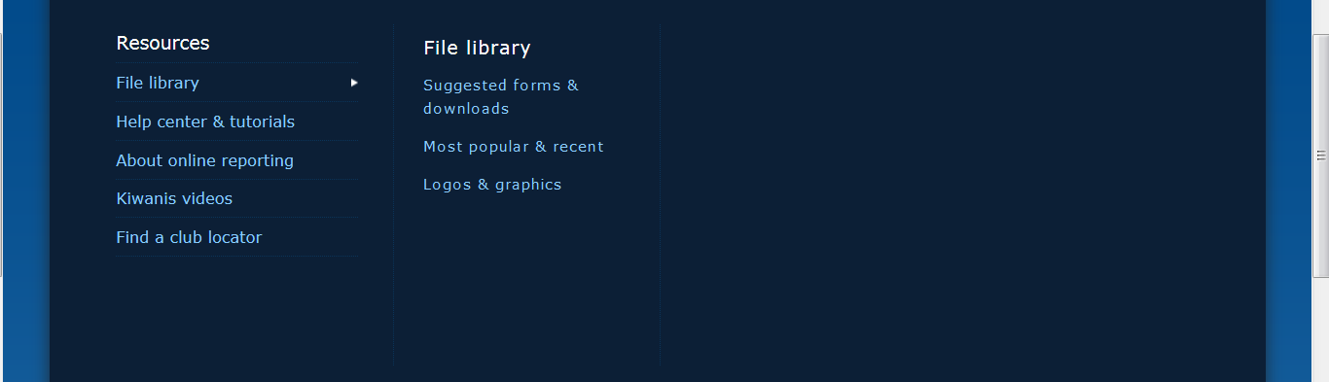
www.kiwanisone.org

Slide 22
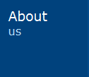
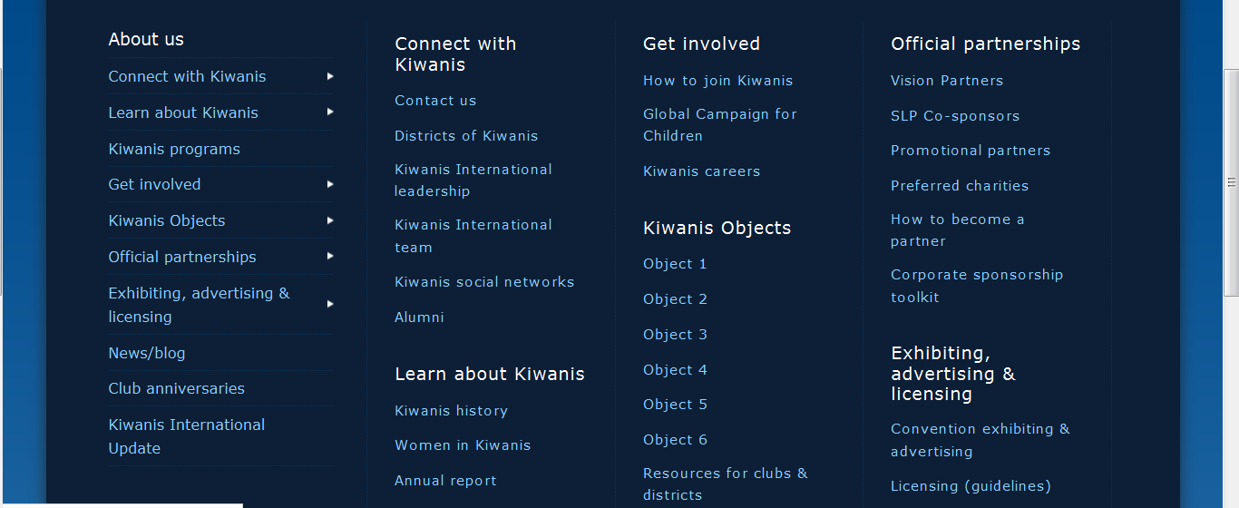
www.kiwanisone.org

Slide 23

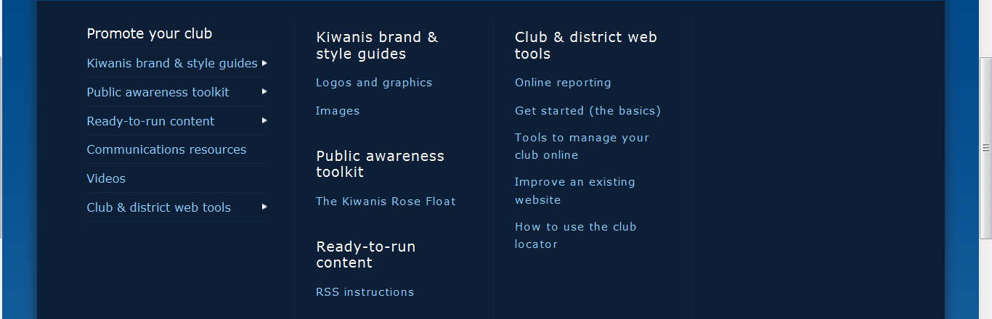
www.kiwanisone.org

Slide 24

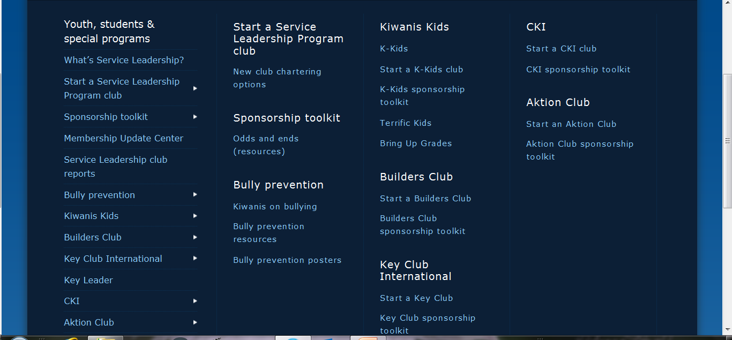
www.kiwanisone.org

Slide 25


Back to
Once successful at logging in you will see a spot for “Organization”
The “down arrow” at the right of the organization box would indicate you have more than 1 choice of organization to log into. Click on it an choose accordingly then “Log in”.

Slide 26
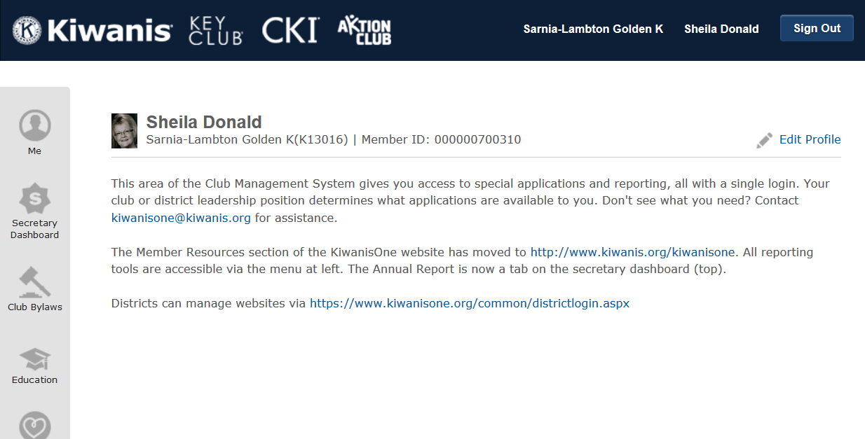

Club or District Leadership position determines your access to applications listed on the left side of the screen

Slide 27

Shows your club key number and member ID number
Gives you the ability to keep your own information up to date

Slide 28

Main information – biography, home address, seasonal address, business address
Contact information – e-mail, phone numbers, Facebook, Pinterest, Linkedin, Google+, Twitter accounts or personal web address
Education and Professional backgrounds
Spouse/partner information
Remember to click at the bottom of the page when you are done any edits

Slide 29
Personal Education
2 great questions –
Where do I go to participate in KI on-line education?
Where do I find KI webinars – past and future?

Slide 30
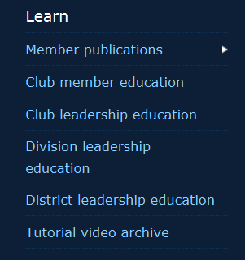
Your education journey starts on the Kiwanis One web site – www.kiwanisone.org
Hover your cursor over the “Learn” tab
Sub-menus appear

Slide 31
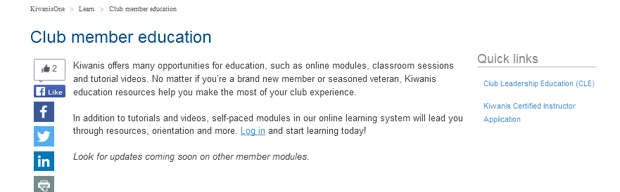
Click on “Club Member Education”
A new screen appears. Read the instructions and follow the line to “Log In”

Slide 32
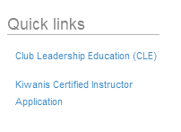
Quick links on the right hand side of the screen is a shortcut to what is listed.

Slide 33
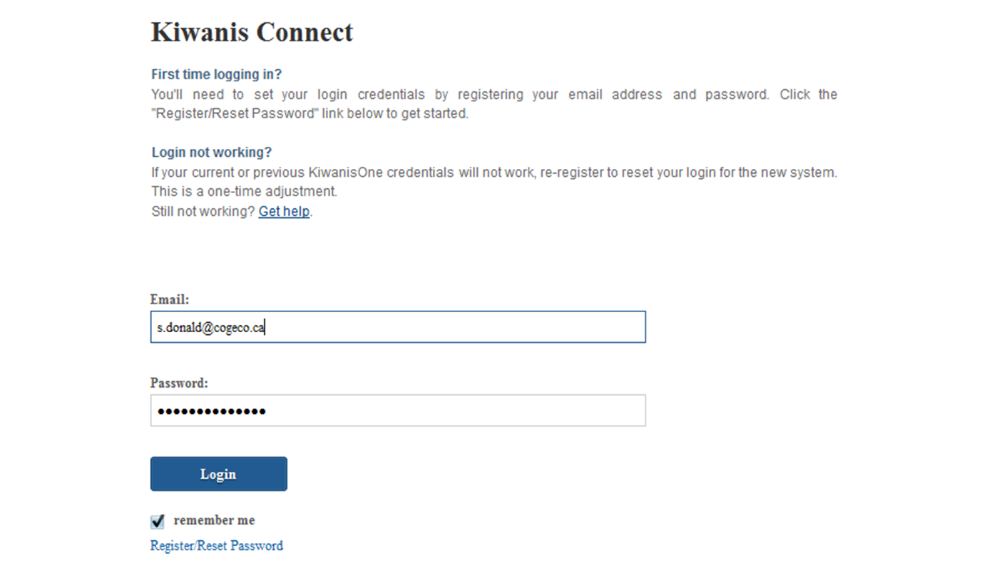
Log into Kiwanis Connect – pick your club on the next screen

Slide 34
The Education tab is listed on the left hand side of the screen. Click on it.

Slide 35
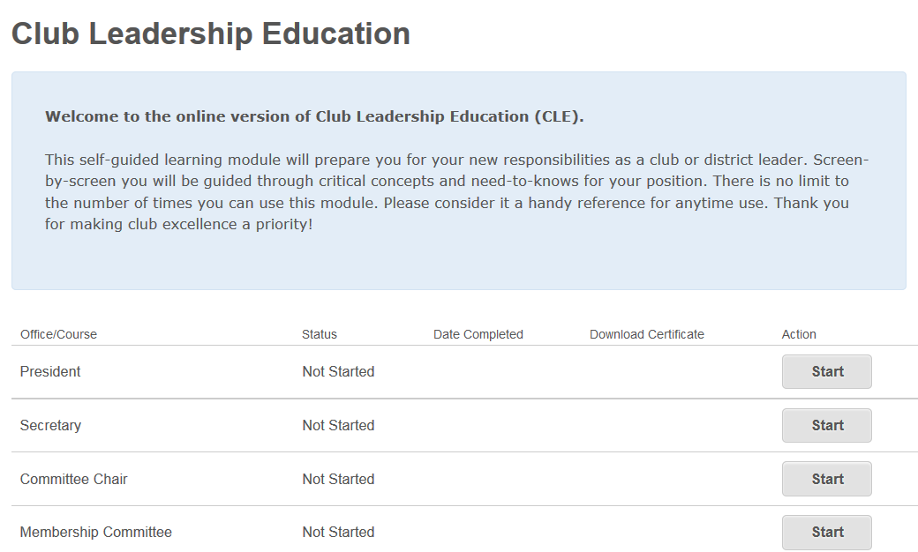
You can review any of the educational modules listed – it is self-paced – you don’t have to hold a club position to learn!

Slide 36
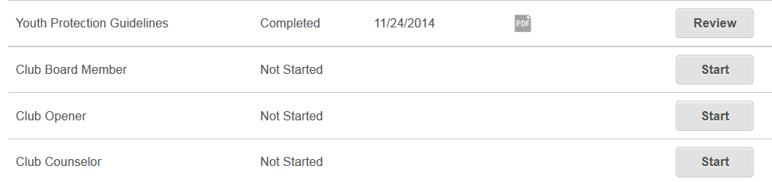
You can begin your education journey, sign off of the module and return in a day or two and pick up where you left off.

Slide 37
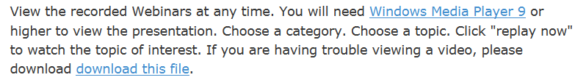
Webinars
Under the “Learn” tab on the Kiwanis One web site you will see a link called “Tutorial Video Archive”
A new screen appears
Webinars are listed by categories

Slide 38

Lots to discover on the Kiwanis One website
It takes time and a lot of clicking
Handy “Search” engine at the top of the page
You can’t break it!
Be bold and adventurous
Having trouble finding something – contact memberservices@kiwanis.org

Slide 39

Questions??

Slide 40
For electronic copies of this presentation please send an
e-mail to s.donald@cogeco.ca or go to the education tab on the EC&C website to download.
Thank you!
Merci!

