Slide 1


AN EASTERN CANADA AND CARIBBEAN DISTRICT
EDUCATION MODULE
Updated March 22, 2017

Slide 2
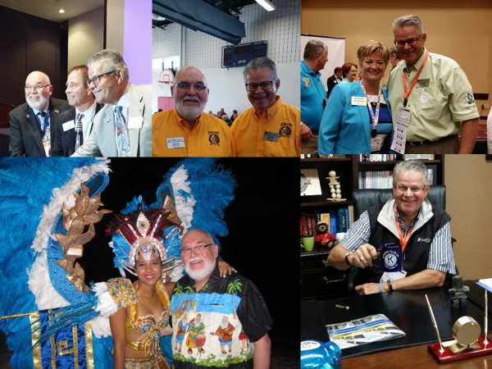

Slide 3
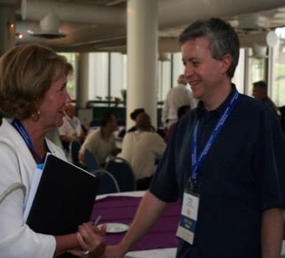
To educate all members regarding their responsibility to the voting delegates who represent their club’s interest at District and International Conventions.

Slide 4
Outcomes:
All members including club presidents, voting delegates and Lieutenant Governors will have a fuller understanding of the role of the delegate and their individual responsibilities in supporting the voting process at conventions; all members will benefit from the education component delivered at conventions.

Slide 5

Eastern Canada and Caribbean District
of Kiwanis International Annual Convention
Ottawa, ON
May 18-20, 2017

Slide 6


Kiwanis International Convention
Paris, France
July 13 – 16, 2017

Slide 7
DUTIES OF THE
CLUB PRESIDENT

Slide 8
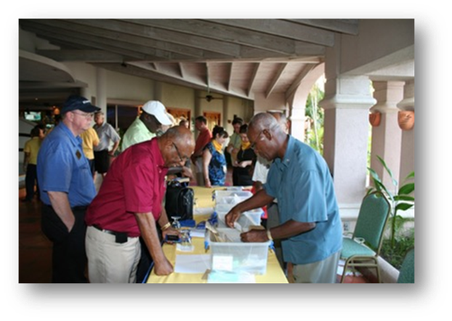
The president encourages financial support in the club’s budget in order to assist voting delegates with convention registration costs and travel expenses.
The president encourages financial support in the club’s budget in order to assist voting delegates with convention registration costs and travel expenses.

Slide 9
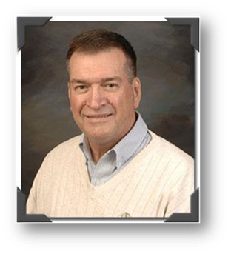
In accordance with club by-laws, the club president ensures that voting delegates are elected in a timely manner relative to the date of the convention and that notice of the delegate election is sent to the appropriate Kiwanis International or District Office contact depending on the convention .
DST Jim Steele

Slide 10
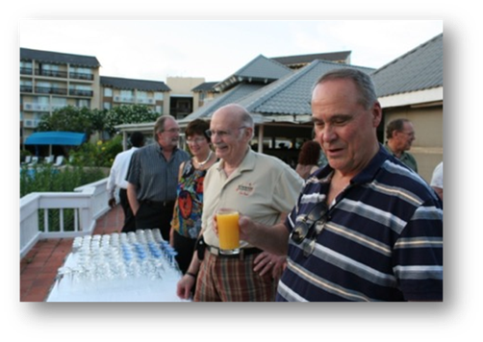
Ample time is provided at a club meeting for the presentation of by-law amendments and resolutions that will come before the House of Delegates.

Slide 11
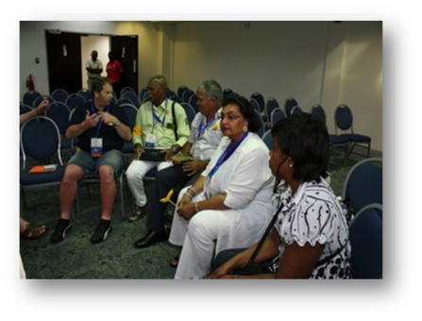
A streamlined approach is adopted for delegates to receive input from the membership regarding their opinion on issues that will be voted on at the convention.

Slide 12
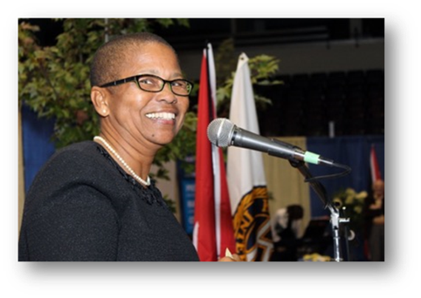
Prior to the convention, materials received regarding candidates seeking election for higher office are circulated.

Slide 13
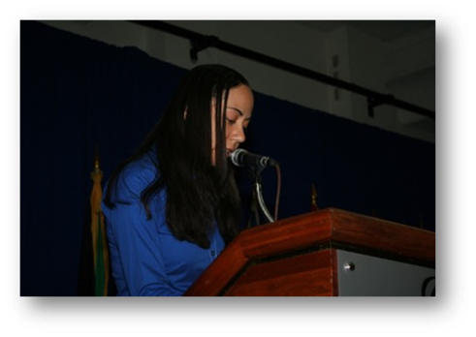
After the convention, ample time is provided at a club meeting for a full convention report by the delegates.

Slide 14
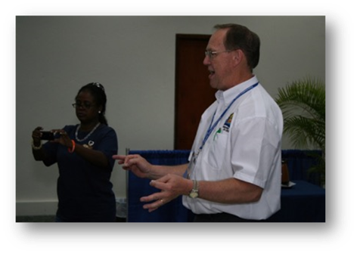
Arrangements are made for the delegates to be program speakers at a regularly scheduled meeting, to ensure an education presentation regarding the forums attended at the convention are shared.

Slide 15
DUTIES OF THE MEMBER

Slide 16
To consider all input received from the membership regarding the matters that will come before the House of Delegates at a convention.

Slide 17
To provide delegates with an informed opinion regarding the matters that will come before the House of Delegates for a vote.

Slide 18
The member will be a participant in the education presentations the delegates will make at a club meeting after the convention.

Slide 19
DUTIES OF THE DELEGATE

Slide 20
Proposed Amendments
for consideration at the
Eastern Canada and the Caribbean
District Convention
Ottawa, ON
May 18-20, 2017
Prior to the convention, the delegate will receive the opinions expressed by the club members regarding by-law resolutions, amendments, regulations and elections presented to the House of Delegates.

Slide 21
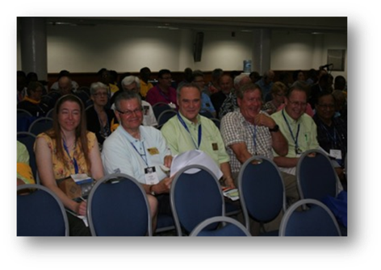
Attend all House of Delegates sessions at the convention.

Slide 22
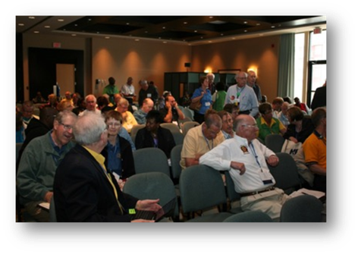
Cast votes on the items that come before the House of Delegates accordingly taking into consideration input from club members or the specific direction of the club.

Slide 23
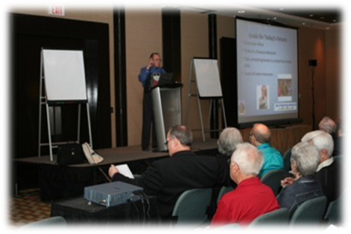
Attend as many education forums as possible during the course of the convention; consult with fellow club delegates regarding forums to be attended in order to gather as much information as possible to report back to the club.

Slide 24
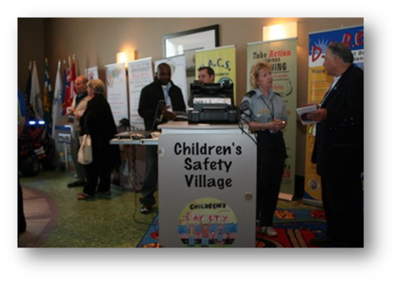
Gather relevant information from the exhibitors at the convention on behalf of the club

Slide 25
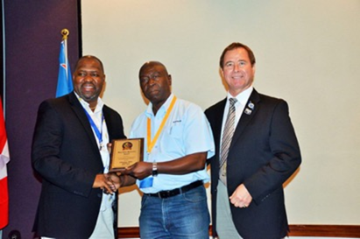
After the convention, make a full report to the club regarding the outcomes and events of the convention

Slide 26
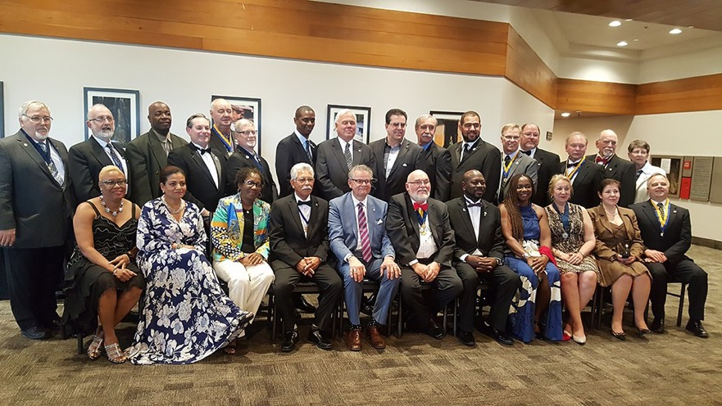
Lt. Governors Class 2016-2017 and
District Leaders

Slide 27
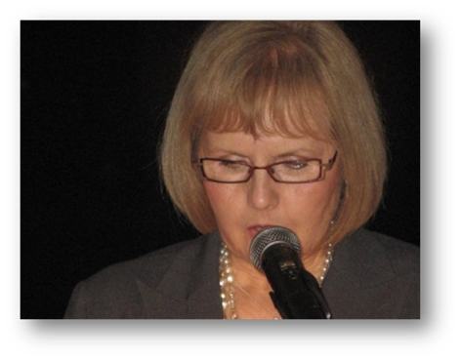
After the convention, as a program speaker, make an education presentation to the club regarding the information received and the forums attended at the convention.

Slide 28


Slide 29
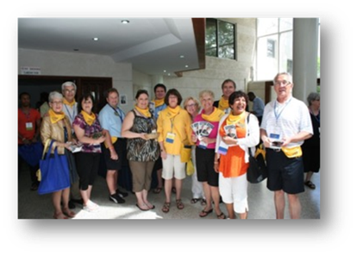
Encourage the clubs of the division to send a full complement of delegates to every convention
International Conventions:
2 delegates,
District Conventions:
3 delegates

Slide 30
In the event that a club is not able to send a delegate, ensure that the club receives a full report regarding the outcomes of the convention.

Slide 31
Follow up with the club presidents to ensure that all duties have been fulfilled.

Slide 32
Education Committee Module:
• REMINDER – in accordance with the District by-laws, there are opportunities for Past Lieutenant Governors to become voting delegates if they are not representing their own club at a District convention:
• Section 8: The delegates and their alternates shall be active or senior members in good standing of the chartered clubs they represent, and further provided that one (1) delegate may be a past or Lieutenant Governor who is a member in good standing of a club in the same division.
• Section 10. Each Division of the District may appoint three (3) Past Lieutenant Governors who are active or senior members of a Kiwanis Club in good standing in the Division, duly elected at a Divisional Council prior to that next District Convention, who shall have the privilege and right to vote as delegates-at-large at that said District Convention.

