Slide 1

Kiwanis Etiquette at Meetings
Prepared by the EC&C District Education Committee 2015
Notes:
Kiwanis

Slide 2

Kiwanis Etiquette at Meetings
Etiquette is about good manners, dignity and respect
Does our behaviour affect our club, its members and its image?
What are some of the issues commonly
raised?
Notes:
Kiwanis

Slide 3

A Common Problem – Talking
It is not kind to speak while others are speaking. It is usually perceived as:
- rude and disrespectful
- distracting to others trying to listen
- we want to impress guests, potential members or our own members
Notes:
This is a universal problem at meetings and gatherings of all groups and organizations. Let’s make Kiwanis unique and not have this problem. It will be noticed by everyone, including our own members.

Slide 4

A Common Problem - Talking
What about talking during a presentation?
- Speakers are often nervous, maybe even afraid
- Excited and eager to share with audience
- Time invested in presentation
- Often takes courage to speak in public
Notes:
We should ask ourselves, if I was this speaker, how would I feel about the attention I was given during my presentation? Would I want to return again or perhaps even join this group? Do we respect their efforts regardless of the appeal to us personally?

Slide 5

Talking – what are we saying?
We don’t want the speaker to be thinking any of these thoughts -
- They are not interested in what I have to say
- They don’t care about my efforts, feelings or how hard this is for me to do
- Their conversation is more important than my presentation
Notes:
The speaker is our invited guest – they deserve the same attention and respect as someone invited to your home.

Slide 6
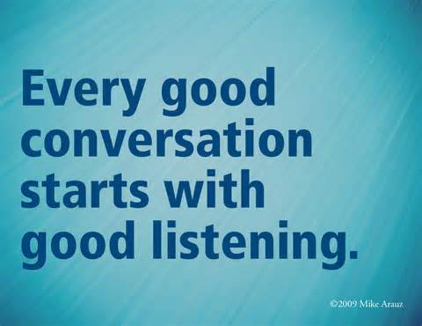
Talking – what are we saying?
We don’t want our members thinking any of these thoughts -
- I can’t hear because there are members talking
- I’m not concerned about our image even though we all look bad when this happens
- My conversation is more important
Notes:
It is not only the speaker who deserves good manners and respect – others in the audience do as well.

Slide 7
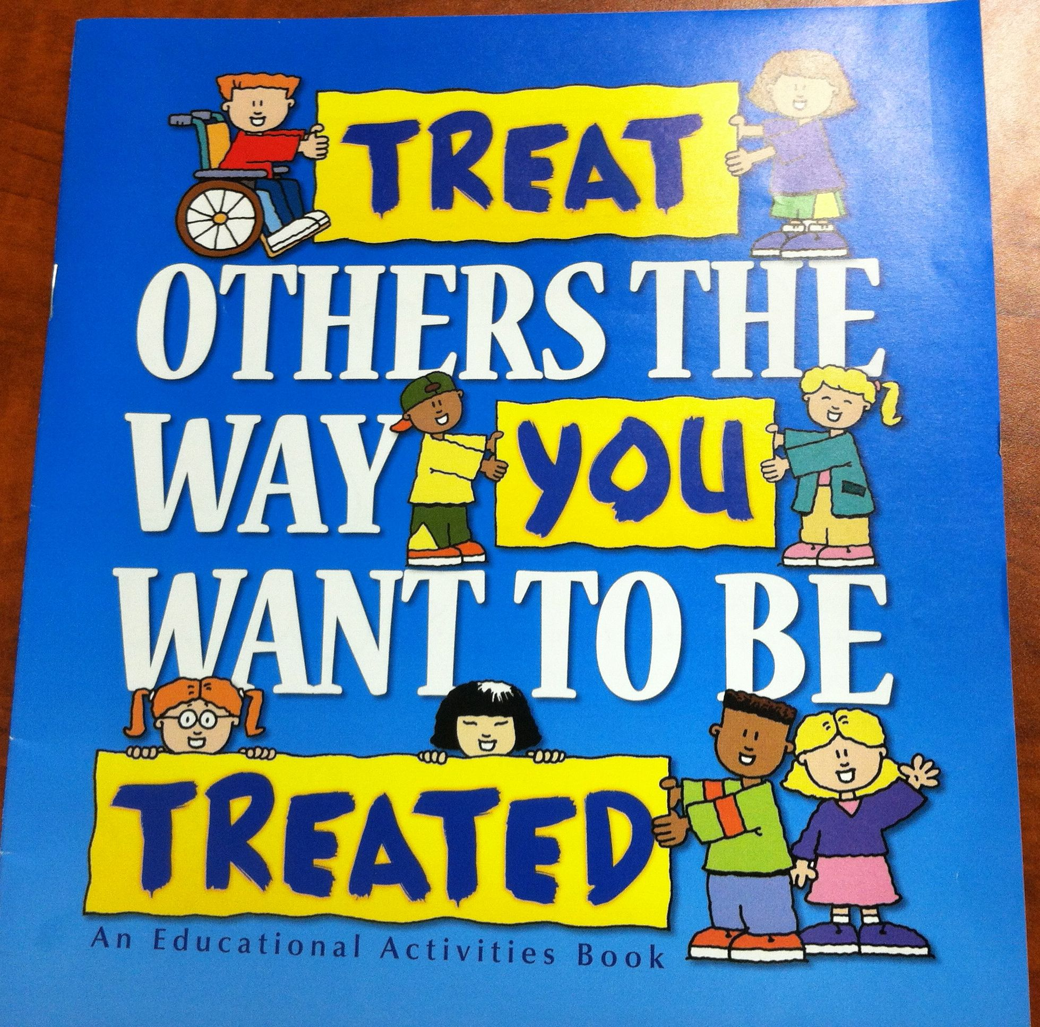

Talking – remember……
- Both whispering and talking in a normal voice is distracting
So is the use of cell phones or tablets – it’s a good idea to turn off or set to vibrate only. If you have to take a call, leave the room before beginning your conversation.
- The Golden Rule is in effect at all times

Slide 8

Talking – what to do?
Make being quiet during presentations a goal in your club
no conversation when others have the floor Remember - It takes 2 to converse.
- SSSSSSSSHHHHHHH works well – verbally and finger to the lips (also the zipper)
- Presidents – you can ring the bell to gain back control

Slide 9
Talking – what to do?
- Speakers can just stop talking until it is quiet
- This can be embarrassing for both the speaker and the audience members
- Fun Master - fines for talkers

Slide 10

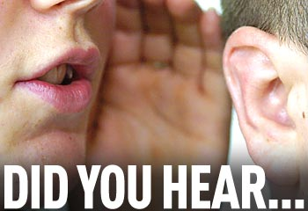
What about Other Issues?
- Off coloured jokes and improper language are “no-no’s” at a Kiwanis meeting
- Your audience will be more engaged when you keep your stories short and to the point –”brevity is the soul of wit”
- Use microphone I available
- Still can’t hear? Move closer, it will help a great deal
- It is a good idea not to gossip or chastise anyone. It does not make a person feel better.

Slide 11

Other Issues
- We are all volunteers – ask us to participate, don’t dictate to members regarding tasks, opinions, decisions etc.
- Majority Rules – accept and support democratic club decisions. Enthusiastic discussion is always encouraged as long as you don’t have a personal agenda or are trying to alter the will of the club.

Slide 12
Other Issues
Leaving during a meeting
- Some people have legitimate reasons for leaving – work, appointments tec.
If others are leaving “just because”, maybe we need to ask ourselves why?
Time and effort is spent by various people to keep the club membership up to date and informed. Let’s all respect that.
Notes:
Are people leaving for legitimate reasons or disinterest? Consider giving the President and the Speaker a heads up that you must leave early.

Slide 13
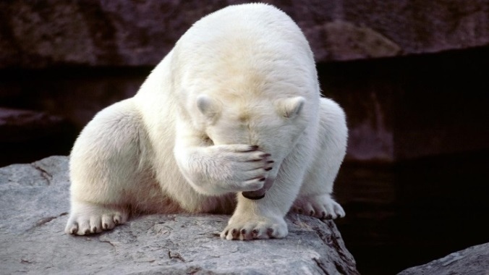
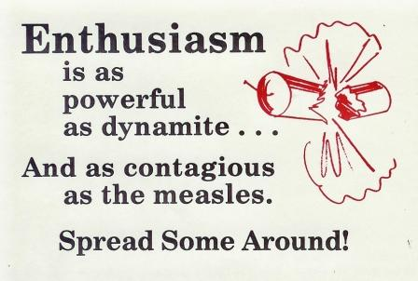
Kiwanis Emotions….
What we do and say can invoke .......
- frustration, embarrassment, resentment, disappointment, hurt, sadness, anger, fear
OR
- excitement, pride, joy, enthusiasm, love, support, friendship, AWESOMENESS …..

Slide 14

Emotions - which do you prefer?
We are KIWANIANS – let’s be different, let’s be better!
Let’s be AWESOME!

Slide 15
Questions ?
Comments?

