Slide 1
New member orientation
Notes:
We’ve learned that a thorough orientation is an important member retention tool, so we prepared this presentation for you to share with new members at your club.
Feel free to make this presentation your own. Save it electronically, fill in the blanks or tailor the slides to meet your club’s needs. If you decide to add new slides, please maintain the integrity of the Kiwanis graphic standards by using the “Insert New Slide” function.
Here’s the equipment you’ll need:
Instructor’s guide (the PowerPoint notes pages)
A laptop computer, the PowerPoint file and a LCD projector if large group
A handout of slides for participants
A DVD player, sound and selected videos from www.KiwanisOne.org.
Be sure to set up and test your equipment in advance.

Slide 2
Welcome to Kiwanis!
Notes:
Ask an existing member (in addition to the sponsor) to mentor each new member.

Slide 3

Who we are
What is Kiwanis?
Kiwanis is a global organization of volunteers dedicated to improving the world one child and one community at a time.
Notes:
The defining statement (on the slide) offers a quick and thorough answer to the question “What is Kiwanis?”
Presenters may want to memorize the defining statement and share it with others along with what the district and club is doing to change the community.
The more the community understands Kiwanis, the easier it will be to get publicity, build clubs and recruit members.

Slide 4
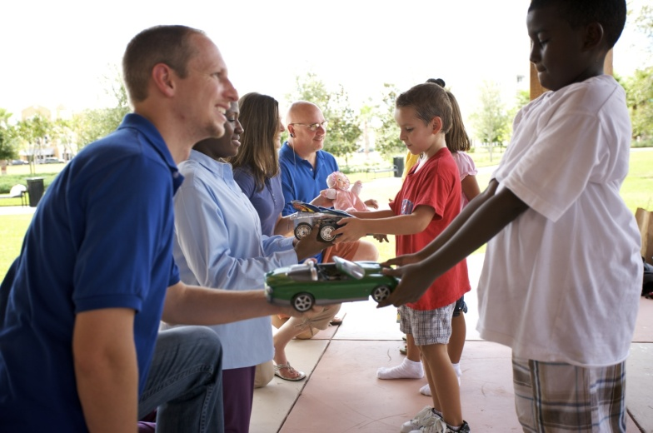
Who we are
Why are we here?
To improve lives through fellowship in service worldwide
How long have we been here?
1915
Where is Kiwanis?
7,800 Kiwanis clubs in 80 countries
Notes:
The organization’s international office is located in Indianapolis, Indiana.
While our club directly impacts our community, there are more than 7,800 clubs all over the world doing the same thing. Together, our efforts are changing the world we live in.

Slide 5
The Kiwanis Objects
1. To give primacy to the human and spiritual rather than to the material values of life.
2. To encourage the daily living of the Golden Rule in all human relationships.
3. To promote the adoption and the application of higher social, business, and professional standards.
Notes:
The Kiwanis International Objects are our guiding principles.
They were approved by Kiwanis club delegates at the 1924 convention in Denver, Colorado. They’ve inspired generations of Kiwanians—and they still hold true today.

Slide 6
The Kiwanis Objects
4. To develop, by precept and example, a more intelligent, aggressive, and serviceable citizenship.
5. To provide, through Kiwanis clubs, a practical means to form enduring friendships, to render altruistic service, and to build better communities.
6. To cooperate in creating and maintaining that sound public opinion and high idealism which make possible the increase of righteousness, justice, patriotism, and goodwill.
Notes:
The Kiwanis International Objects are our guiding principles.
They were approved by Kiwanis club delegates at the 1924 Convention in Denver, Colorado. They’ve inspired generations of Kiwanians—and they still hold true today.

Slide 7

Who we are
What do we do?
Each year, Kiwanis clubs:
  Sponsor nearly 150,000 service projects
  Raise more than US$107 million
  Devote more than 6 million hours
  to service
Our motto: Serving the children of the world

Slide 8
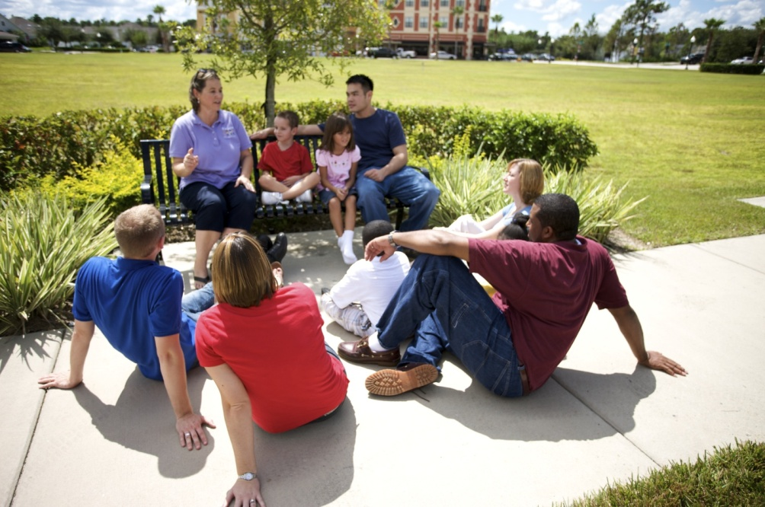
Member benefits
What’s in it for me?
  Change children’s lives
  Improve the community
  and the world
  Build friendships
  Enhance leadership skills
  Develop business contacts
Notes:
It is important that new members have an opportunity to participate in a service project right away.

Slide 9


Member benefits
More perks…
  Kiwanis magazine
  Club communications
  Insurance coverage for
  Kiwanis club projects
  Directors and Officers
  insurance for club leaders

Slide 10
Member benefits
Club benefits
[list club benefits here]
Division benefits
[list division benefits here]
District benefits
[list district benefits here]
Notes:
Include club, division or district benefits (i.e. district and club newsletters, education conferences, leadership education).
Delete any content that is not relevant to your club.

Slide 11
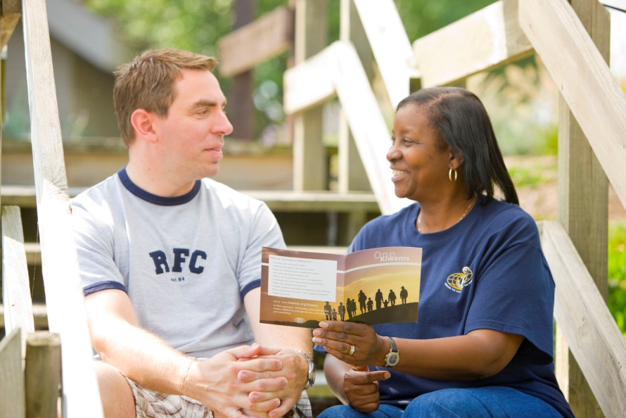
Expectations
What do I need to do?
  Attend club meetings
  Take part in club service and fundraising projects
  Spread the word about Kiwanis
Notes:
Welcome new members warmly. Don’t intimidate them by suggesting harsh attendance requirements. Encourage regular attendance by sharing the benefits—friendship and making a difference in the community. More importantly we need to stress participation in club projects – become “mission driven”.

Slide 12
About our club
Club name:
Charter date:
Meeting day, time and place:
Notes:
You may also want to share your club’s active charter members and Legion of Honor members.
Legion of Honor members have 25 years of Kiwanis service.
Some clubs start meetings with an invocation and singing, some do not. It is important that club traditions are evaluated annually to ensure that they continue to meet the members’ needs. Assure the new member that his/her preferences will be considered when club traditions and club meetings are evaluated.
Describe a typical club meeting including format and timing (and timeliness), seating (hopefully “open”) and club traditions such as Happy Dollars. It is extremely important to explain to new members (and guests) what to expect (singing, meals, committee reports, etc.) so they feel comfortable at the first few club meetings.

Slide 13
About our club
Our club’s traditions
[list traditions]
Notes:
Describe a typical club meeting including format and timing (and timeliness), seating (hopefully “open”) and club traditions such as Happy Dollars. Take time to explain to new members (and guests) what to expect (singing, meals, committee reports, etc.) so they feel comfortable at the first few club meetings.
Some clubs start meetings with an invocation and singing, some don’t. (Be sure to evaluate your club’s traditions annually to ensure that they continue to meet the members’ needs.) Assure the new member that his or her preferences will be considered when club traditions and club meetings are evaluated.

Slide 14
About our club
Our club leaders
President:
Immediate past president:
President-elect or vice president:
Secretary:
Treasurer:
Notes:
Note: Explain that officers change with each administrative year, which begins October 1.
Describe the election process for club directors and officers. Share the date of the club’s next Annual Club Meeting which is likely in April or May.
Encourage new members to consider running for office.
Explain what the annual club meeting is.
Share the date of the club’s next annual club meeting which is likely in April or May.

Slide 15
Service projects
How can I help?
[list your club’s service projects here]
Notes:
Give new members an opportunity to participate in a service project right away.
Service projects provide the opportunity for both service and fellowship that most of our new members are seeking. List the club’s major service projects here or add more slides to describe the club’s current major service projects. Find out if the new member has a particular interest in one of those or has suggestions for other projects.

Slide 16

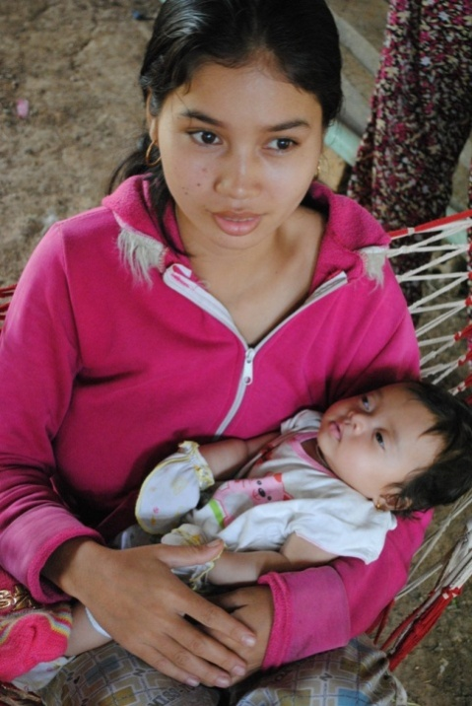
Service projects
The Eliminate Project
  Partnership with UNICEF
  Goals:
    To eliminate maternal/neonatal tetanus
    To complete the collection of pledges of
    $110 million US
  Opportunities to serve at club level
www.TheEliminateProject.org
Notes:
This is Kiwanis International’s new global campaign for children.
Our goal is to raise $110 million by 2015 to fight maternal/neonatal tetanus.
Share your club’s plans for involvement in the project.
If you’d like to share more information about the project, you can find resources including a PowerPoint presentation at www.TheEliminateProject.org.

Slide 17
Fundraising
Our club’s fundraising projects
[list here]
Notes:
List the club’s major fundraising projects and encourage the new member to participate. As with service projects and committee assignments, relationships are forged by participating in the activities of the club.

Slide 18
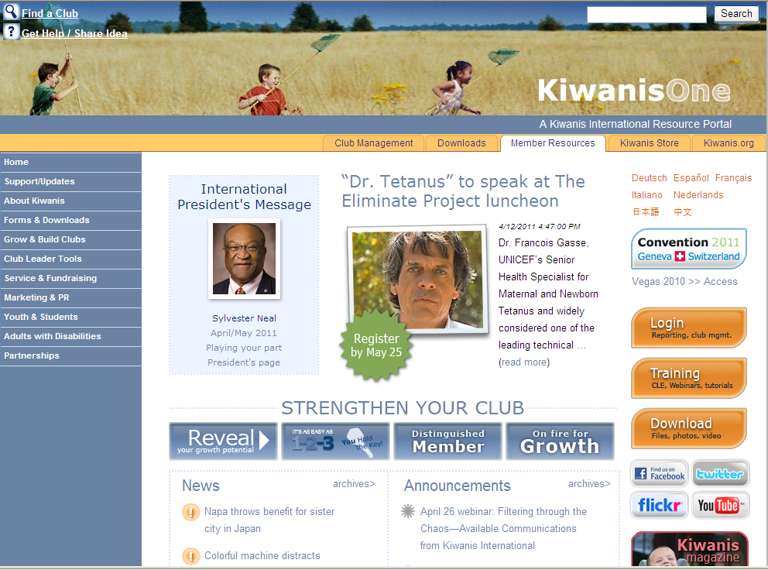
Communication
How will I know what’s going on?
  Club meetings
  Newsletters—club, division and district
  Websites
    Kiwanis International:
    www.KiwanisOne.org
    District: www.kiwanisecc.org
    Club: [list club website here]
  KIWANIS magazine
  Social media sites
    Facebook
    Twitter
Notes:
Sharing information is critical to keeping members engaged. Describe each of these communication vehicles. Ask members to consider providing their e-mail address to Kiwanis International when they join your club. Upon receipt, the new member will receive an e-mail invitation to the New Member e-Welcome Kit that contains special information just for new members.
Take time to show members the Kiwanis International websites—www.kiwanis.org and www.KiwanisOne.org. Share the URLs for your club and district websites too.

Slide 19
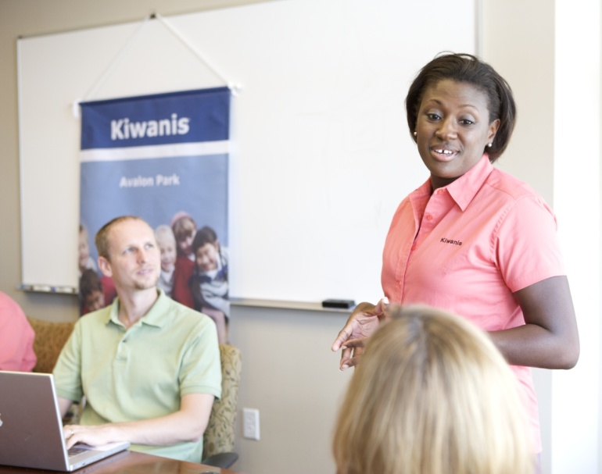
Participation
How do I get involved?
  Attend club meetings
  Participate in service and fundraising projects
  Attend district council meetings
  Participate in inter-club
  meetings
  Serve on committees
  Run for office
Notes:
Now we’ll share more information on our structure to give you a better understanding all these opportunities.

Slide 20
Structure
Kiwanis International Structure
  Club XX members of our club
  Division XX clubs in our division
  District XX clubs in our district
Kiwanis International
  7,800 clubs in 47 districts
  Nearly 315,000 adult members
  Nearly 354,000 youth members
Kiwanis
Clubs
Kiwanis
Districts
Kiwanis
International
Notes:
Members will benefit from knowing more about your district and how your club fits in to the overall Kiwanis structure. If you’d like to present more information about your structure, contact your Kiwanis district office for the latest details.

Slide 21
Structure
Division name and/or number:
Lieutenant governor:
Other clubs in our area:
Division projects [if any]:

Slide 22
Structure
Our District is “The Eastern Canada and the Caribbean District of Kiwanis International”
District officers
Governor: Phillip Rossy – Kiwanis Club of Ottawa
Immediate Past Governor : Allen Ure – Kiwanis Club of Ridgetown
Governor-elect: Bobby Moo Young – Kiwanis Club of Montego Freeport
Vice Governor: Melford Clarke – Kiwanis Club of Cable Beach, Nassau
District Secretary Treasurer: Jim Steele – Kiwanis Club of Brantford
Total members in the district: 6900

Slide 23


Structure
Club committees
Community services
Service Leadership Programs
Young Children: Priority One
Human and spiritual values
Club administration
Membership
Education
Public relations
Finance and fundraising
Notes:
We already mentioned our club officers.
Committees provide opportunities for participation and leadership.
Hint: You might change this slide to reflect all of the club’s committees and their current leaders.
These are the standard committees listed in the Kiwanis International bylaws. Larger clubs may have more so everyone can be active; some small clubs combine or prioritize these committees. Focus on the work the club needs or wants to accomplish. Describe what each committee does. Club committees are where the work gets done and relationships are forged. Encourage new members to find a committee that interests them and to play a part.

Slide 24
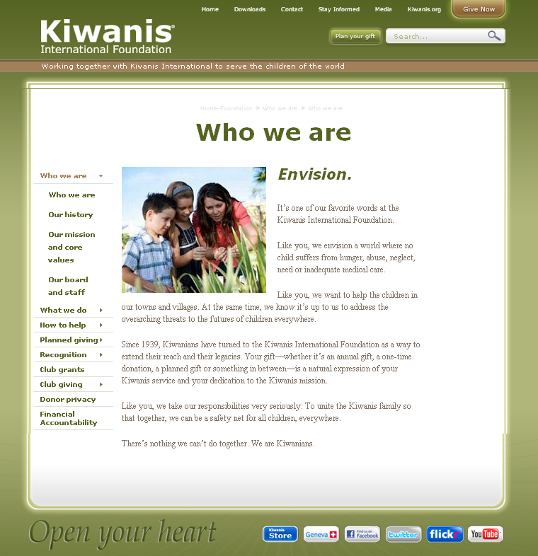
Structure
The Kiwanis International Foundation
  You are a member!
  Charitable fundraising entity
  of Kiwanis International
  Funds grants for activities
  and programs
  Annual club gift campaign
  Personal philanthropy
  www.Kiwanis.org/foundation
Notes:
The Kiwanis International Foundation will solicit funds directly from our members (via postal mail).
The Kiwanis International Foundation collects and channels funds for Kiwanis International’s global campaign for children—The Eliminate Project.
Share with the new member any other ways that the club also supports the Kiwanis International Foundation.
The Kiwanis International Foundation:
Supports the Kiwanis community on a global scale.
Provides the recognition and publicity for club contributions.
Provides money for matching scholarships to Key Clubs and Circle K clubs in your district.
Provides grants to clubs and districts to provide service to children.
Provides funds to support Kiwanis family programs at the International level.
Differentiate between the Kiwanis International Foundation and district/club foundations.

Slide 25







Structure
Kiwanis Service Leadership Programs
  The largest and oldest youth service clubs in the world
  Program for adults living with disabilities
  341,000 members worldwide
Notes:
Ask about new members’ experiences with the Service Leadership Programs. Many are familiar with Key Club and Circle K International but may not associate the programs with Kiwanis.
The visibility of our Service Leadership Programs can be a positive incentive for parents, teachers, school administrators, youth ministers, and others interested in the welfare of youth to learn more about the Kiwanis club in their community.
Encourage members to learn more about these programs by exploring www.Kiwanis.org.

Slide 26
Our club’s service leadership programs
Name:
Meeting time:
Location:
Advisor:
Notes:
Share with the new member which programs this club sponsors or supports.
Members are encouraged to attend meetings.
Add additional slides if needed.

Slide 27



Structure
Kiwanis branded service projects
  Kiwanis One Day
  www.KiwanisOne.org/OneDay
  Read Around the World
  www.KiwanisOne.org/Read
  Young Children: Priority One
  www.KiwanisOne.org/YCPO

Slide 28
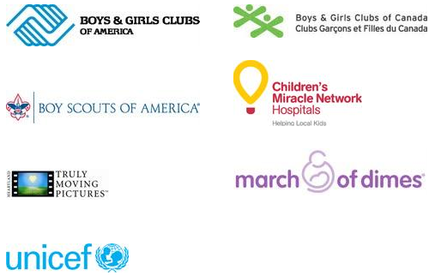
Structure
Kiwanis partnerships
  UNICEF
  March of Dimes
  Boys & Girls Clubs
  (America and Canada)
  Children’s Miracle
  Network Hospitals
  Boy Scouts of America
  Heartland Truly Moving Pictures
  www.KiwanisOne.org/partners

Slide 29
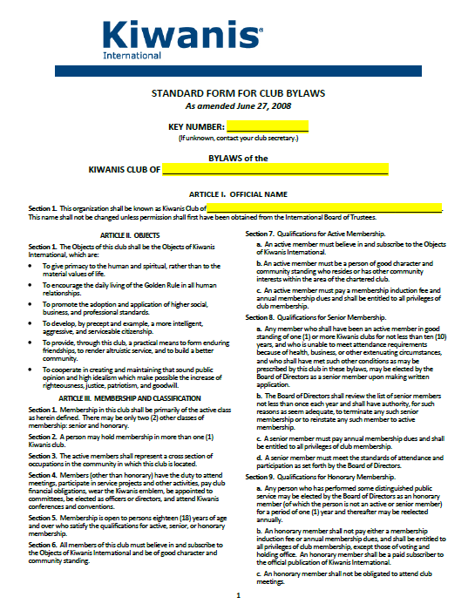
Club business
Standard Form for Club Bylaws
Guidelines
Requirements
Parameters
Covers membership,
meetings, board, officers,
finances
Notes:
Let new members know that the club operates under the parameters of club bylaws. A copy of the Standard Form for Club Bylaws is available at www.KiwanisOne.org.
It might be fun to ask the following questions:
What is minimum age for a Kiwanian? (18 years) Article III, Section 5
Who presides at meetings when the president is absent? (President-elect/Vice president) Article VI, Section 5
How often should the board of directors conduct meetings? (once/month) Article VII, Section 5
Can clubs determine one-, two-, or three-year terms for directors? (yes) Article VII, Section 3
When is the annual club meeting conducted? (April/May).Article XI, Section 5
What is the minimum number of club meetings? (two/month, but one of the two can be an open board meeting or a service project). Article XI, Section 1

Slide 30
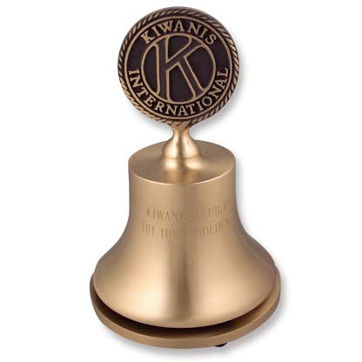
Club business
Members vote to:
  Elect club officers and directors
  Amend club bylaws
The board of directors:
  Determines club policies
  Approves club projects
  Approves and controls club budget
  Manages the club
Notes:
Share with the new member the list of club board members.

Slide 31

Club business
Board of directors meeting
  All members are welcome.
  Only board members can vote.
Day:
Time:
Location:
Notes:
Explain that all members are welcome to attend board meetings, but only board members and officers may vote.

Slide 32

Club business
Finance and budget
Administrative account
  Income from club dues,
  meal charges, new member fees
  Used to pay administrative expenses of club
Service account
  Income from public fundraising projects or contributions
  Cannot be used to pay administrative expenses of club
Notes:
In the United States……
Currently (October 1, 2010), Kiwanis clubs are classified as 501(c)4 and dues/donations are not tax deductible.
Some clubs have 501(c)3 foundations that can accept tax deductible contributions.
Briefly describe the finances of the club and share whether or not the club has a foundation.

Slide 33

Club business
Dues and fees
New member fee
(covers the cost between joining and October 1):
Club dues: $
District dues: $
Kiwanis International dues: $
Total annual dues: $
Notes:
If applicable, describe additional “typical” costs of membership. If your club meets during a meal time, what is the expected cost of the meal? Is it expected that members will contribute to Happy Dollars, division/district events, foundations, etc?

Slide 34

Conventions
Conventions
  District midyear conference
  District convention
  Kiwanis International convention
  Key Club International convention
  Circle K International convention
  Key Club and Circle K International also have
  district conventions.
Notes:
Kiwanis International conducts an annual convention, which is held to:
Elect International Board members
Amend the International Bylaws
Conduct leadership and membership education
Provide Kiwanis fellowship
Provide Kiwanis education
Provide guidance and inspiration for clubs
Each club is entitled to send two delegates and two alternates to the International convention. These delegates compose the House of Delegates and vote on the election of officers and new members to the Board of Trustees, resolutions, and proposed amendments to the International Bylaws.
District conventions and conferences achieve the same objectives but at the district level. Some districts have regional meetings. If this is applicable to your district, please make the necessary changes to the slide.
Discuss dates and locations of upcoming conventions and, if appropriate, club policies for sending members to each of these events.

Slide 35

Questions?

